Slide 1
Chapter 9
Dynamic Decision Processes
Learning objectives :
Able to model practical dynamic decision problems
Understanding decision policies
Understanding the principle of optimality
Understanding the relation between discounted and average-cost
Derive decision structural properties with optimality equation
Textbooks :
C. Cassandras and S. Lafortune, Introduction to Discrete Event Systems, Springer, 2007
Martin Puterman, Markov decision processes, John Wiley & Sons, 1994
D.P. Bertsekas, Dynamic Programming, Prentice Hall, 1987

Slide 2
Plan
Dynamic programming
Introduction to Markov decision processes
Markov decision processes formulation
Discounted markov decision processes
Average cost markov decision processes
Continuous-time Markov decision processes

Slide 3
Dynamic programming
Basic principe of dynamic programming
Some applications
Stochastic dynamic programming

Slide 4
Dynamic programming
Basic principe of dynamic programming
Some applications
Stochastic dynamic programming

Slide 5
Introduction
Dynamic programming (DP) is a general optimization technique based on implicit enumeration of the solution space.
The problems should have a particular sequential structure, such that the set of unknowns can be made sequentially.
It is based on the "principle of optimality"
A wide range of problems can be put in seqential form and solved by dynamic programming

Slide 6
Introduction
Applications :
  • Optimal control
  • Most problems in graph theory
  • Investment
  • Deterministic and stochastic inventory control
  • Project scheduling
  • Production scheduling
We limit ourselves to discrete optimization

Slide 7
Illustration of DP by shortest path problem
Problem : We are planning the construction of a highway from city A to city K. Different construction alternatives and their costs are given in the following graph. The problem consists in determine the highway with the minimum total cost.
14
D
3
B
I
G
10
8
10
9
A
E
5
K
10
9
10
8
C
8
H
J
7
F
15

Slide 8
BELLMAN's principle of optimality
General form:
  if C belongs to an optimal path from A to B, then the sub-path A to C and C to B are also optimal
or
  all sub-path of an optimal path is optimal
A
B
C
optimal
optimal
Corollary :
SP(xo, y) = min {SP(xo, z) + l(z, y) | z : predecessor of y}

Slide 9
Solving a problem by DP
1. Extension
  Extend the problem to a family of problems of the same nature
2. Recursive Formulation (application of the principle of optimality)
  Link optimal solutions of these problems by a recursive relation
3. Decomposition into steps or phases
  Define the order of the resolution of the problems in such a way that, when solving a problem P, optimal solutions of all other problems needed for computation of P are already known.
4. Computation by steps

Slide 10
Solving a problem by DP
Difficulties in using dynamic programming :
Identification of the family of problems
transformation of the problem into a sequential form.

Slide 11
Shortest Path in an acyclic graph
• Problem setting : find a shortest path from x0 (root of the graph) to a given node y0
• Extension : Find a shortest path from x0 to any node y, denoted SP(x0, y)
• Recursive formulation
SP(y) = min { SP(z) + l(z, y) : z predecessorr of y}
• Decomposition into steps : At each step k, consider only nodes y with unknown SP(y) but for which the SP of all precedecssors are known.
• Compute SP(y) step by step
Remarks :
• It is a backward dynamic programming
• It is also possible to solve this problem by forward dynamic programming

Slide 12
DP from a control point of view
Consider the control of
a discrete-time dynamic system, with
costs generated over time depending on the states and the control actions
action
action
State t
State t+1
Cost
Cost
present decision epoch
next decision epoch

Slide 13
DP from a control point of view
System dynamics :
  x _{t+1} = f_{t}(x_{t}, u_{t}), t = 0, 1, ..., N-1
where
  t : temps index
  x_{t} : state of the system
  u_{t} = control action to decide at t
action
action
State t
State t+1
Cost
Cost
present decision epoch
next decision epoch

Slide 14
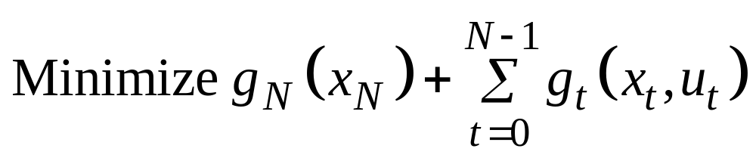
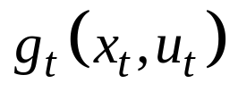
DP from a control point of view
Criterion to optimize
action
action
State t
State t+1
Cost
Cost
present decision epoch
next decision epoch

Slide 15
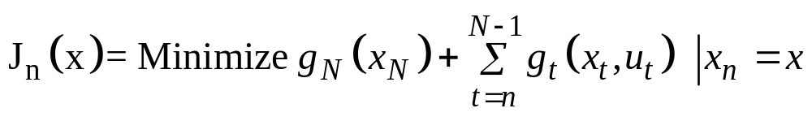
DP from a control point of view
Value function or cost-to-go function:
action
action
State t
State t+1
Cost
Cost
present decision epoch
next decision epoch

Slide 16
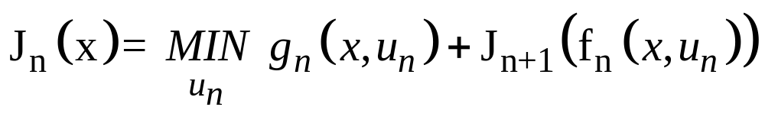
DP from a control point of view
Optimality equation or Bellman equation
action
action
State t
State t+1
Cost
Cost
present decision epoch
next decision epoch

Slide 17
Applications
Single machine scheduling (Knapsac)
Inventory control
Traveling salesman problem

Slide 18
Applications
Single machine scheduling (Knapsac)
Problem :
Consider a set of N production requests, each needing a production time t_{i} on a bottleneck machine and generating a profit p_{i}. The capacity of the bottleneck machine is C.
Question: determine the production requests to confirm in order to maximize the total profit.
Formulation:
max Σ p_{i} X_{i}
subject to:
Σ t_{i} X_{i} ≤ C

Slide 19
Applications
Inventory control
See exercices

Slide 20
Applications
Traveling salesman problem
Problem :
Data: a graph with N nodes and a distance matrix [d_{ij}] beteen any two nodes i and j.
Question: determine a circuit of minimum total distance passing each node once.
Extensions:
C(y, S): shortest path from y to x0 passing once each node in S.
Application: Machine scheduling with setups.
2007

Slide 21
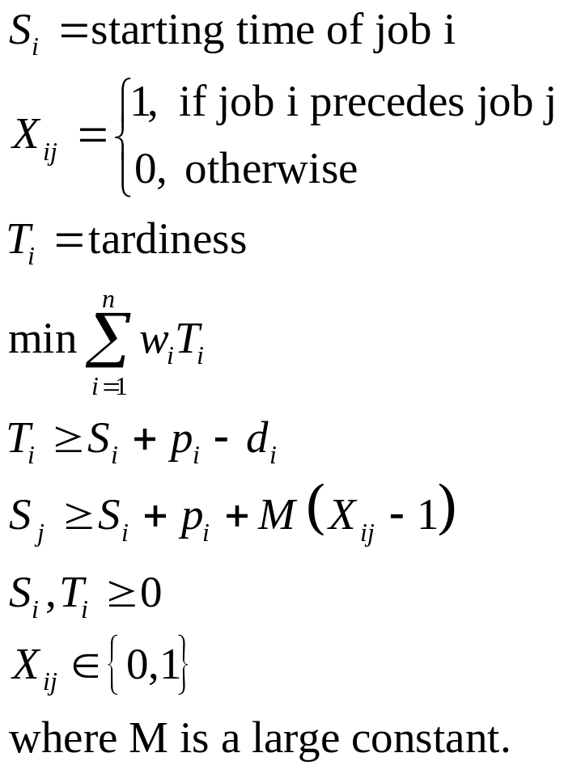
Applications
Total tardiness minimization on a single machine
Job | 1 | 2 | 3
Due date di | 5 | 6 | 5
Processing time pi | 3 | 2 | 4
weight wi | 3 | 1 | 2

Slide 22
Stochastic dynamic programming
Model
Consider the control of
a discrete-time stochastic dynamic system, with
costs generated over time
perturbation
perturbation
action
action
State t
State t+1
stage cost
cost
present decision epoch
next decision epoch

Slide 23
Stochastic dynamic programming
Model
System dynamics :
  x _{t+1} = f_{t}(x_{t}, u_{t}, w_{t}), t = 0, 1, ..., N-1
where
  t : time index
  x_{t} : state of the system
  u_{t} = decision at time t
  wt : random perturbations
perturbation
action
action
State t
State t+1
cost
cost
present decision epoch
next decision epoch

Slide 24
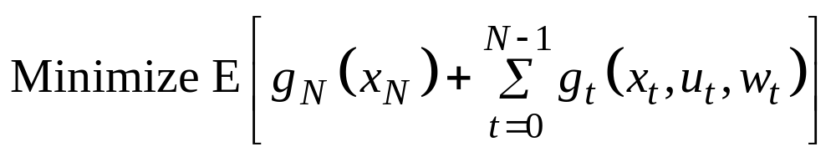
Stochastic dynamic programming
Model
Criterion
perturbation
action
action
State t
State t+1
cost
cost
present decision epoch
next decision epoch

Slide 25
Stochastic dynamic programming
Model
Open-loop control:
Order quantities u₁, u₂, ..., u_{N-1} are determined once at time 0
Closed-loop control:
Order quantity u_{t} at each period is determined dynamically with the knowledge of state x_{t}

Slide 26
Stochastic dynamic programming
Control policy
The rule for selecting at each period t a control action u_{t} for each possible state x_{t}.
Examples of inventory control policies:
Order a constant quantity u_{t} = E[w_{t}]
Order up to policy :
  u_{t} = S_{t} – x_{t}, if x_{t} ≤ S_{t}
  u_{t} = 0, if x_{t} > S_{t}
where S_{t} is a constant order up to level.
2007

Slide 27
Stochastic dynamic programming
Control policy
Mathematically, in closed-loop control, we want to
find a sequence of functions μt, t = 0, ..., N-1, mapping state xt into control ut
so as to minimize the total expected cost.
The sequence π = {μ₀, ..., μ_{N-1}} is called a policy.
2007

Slide 28
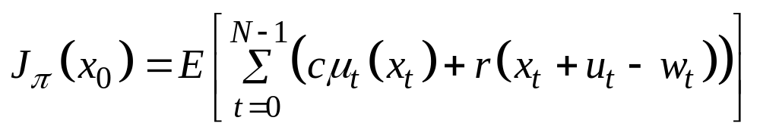
Stochastic dynamic programming
Optimal control
Cost of a given policy π = {μ₀, ..., μ_{N-1}},
Optimal control:
minimize J_{π}(x₀) over all possible polciy π
2007

Slide 29
Stochastic dynamic programming
State transition probabilities
State transition probabilty:
  p_{ij}(u, t) = P{x_{t+1} = j | x_{t} = i, u_{t} = u}
depending on the control policy.
2007

Slide 30
Stochastic dynamic programming
Basic problem
A discrete-time dynamic system :
  x _{t+1} = f_{t}(x_{t}, u_{t}, w_{t}), t = 0, 1, ..., N-1
Finite state space st ∈ St
Finite control space ut ∈ Ct
Control policy π = {μ₀, ..., μ_{N-1}} with u_{t} = μ_{t}(x_{t})
State-transition probability: p_{ij}(u)
stage cost : g_{t}(x_{t}, μ_{t}(x_{t}), w_{t})
2007

Slide 31
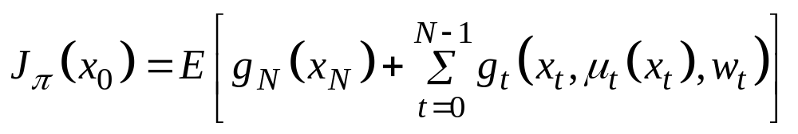
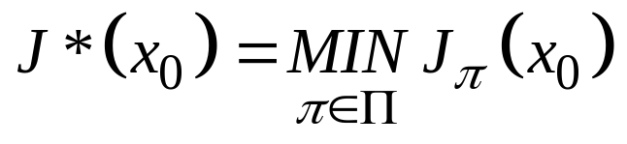
Stochastic dynamic programming
Basic problem
Expected cost of a policy
Optimal control policy π* is the policy with minimal cost:
where Π is the set of all admissible policies.
J*(x) : optimal cost function or optimal value function.

Slide 32
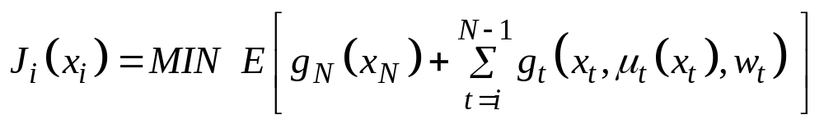
Stochastic dynamic programming
Principle of optimality
Let π∗ = {μ∗₀, ..., μ∗_{N-1}} be an optimal policy for the basic problem for the N time periods.
Then the truncated policy {μ∗_{i}, ..., μ∗_{N-1}} is optimal for the following subproblem
minimization of the following total cost (called cost-to-go function) from time i to time N by starting with state xi at time i

Slide 33
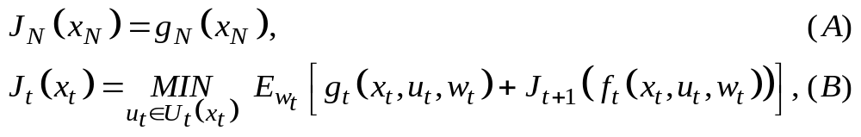
Stochastic dynamic programming
DP algorithm
Theorem: For every initial state x₀, the optimal cost J*(x₀) of the basic problem is equal to J₀(x₀), given by the last step of the following algorithm, which proceeds backward in time from period N-1 to period 0
Furthermore, if u*_{t} = μ*_{t}(x_{t}) minimizes the right side of Eq (B) for each x_{t} and t, the policy π∗ = {μ∗₀, ..., μ∗_{N-1}} is optimal.

Slide 34
Stochastic dynamic programming
Example
Consider the inventory control problem with the following:
  Excess demand is lost, i.e. x_{t+1} = max{0, x_{t} + u_{t} – w_{t}}
  The inventory capacity is 2, i.e. x_{t} + u_{t} ≤ 2
  The inventory holding/shortage cost is : (x_{t} + u_{t} – w_{t})²
  Unit ordering cost is 1, i.e. g_{t}(x_{t}, u_{t}, w_{t}) = u_{t} + (x_{t} + u_{t} – w_{t})².
  N = 3 and the terminal cost, g_{N}(X_{N}) = 0
  Demand : P(w_{t} = 0) = 0.1, P(w_{t} = 1) = 0.7, P(w_{t} = 2) = 0.2.

Slide 35
Stochastic dynamic programming
DP algorithm
Optimal policy
Stock | Stage 0 Cos-to-go | Stage 0 Optimal order quantity | Stage 1 Cos-to-go | Stage 1 Optimal order quantity | Stage 2 Cos-to-go | Stage 2 Optimal order quantity
0 1 2 | 3.7 2.7 2.818 | 1 0 0 | 2.5 1.5 1.68 | 1 1 0 | 1.3 0.3 1.1 | 1 0 0

Slide 36
Instroduction to Markov decision process

Slide 37
Sequential decision model
Key ingredients:
A set of decision epochs
A set of system states
A set of available actions
A set of state/action dependent immediate costs
A set of state/action dependent transition probabilities
Policy:
a sequence of decision rules in order to mini. the cost function
Issues:
Existence of opt. policy
Form of the opt. policy
Computation of opt. policy
action
action
Present
state
Next
state
costs
costs

Slide 38
Applications
Inventory management
Bus engine replacement
Highway pavement maintenance
Bed allocation in hospitals
Personal staffing in fire department
Traffic control in communication networks
…

Slide 39
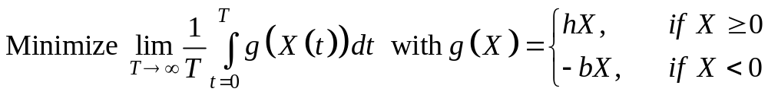
Example
Consider a with one machine producing one product. The processing time of a part is exponentially distributed with rate p. The demand arrive according to a Poisson process of rate d.
state Xt = stock level, Action : a_{t} = make or rest
(make, p)
(make, p)
(make, p)
(make, p)
1
0
2
3
d
d
d
d

Slide 40
Example
Zero stock policy
P(0) = 1-r, P(-n) = r^{n}P(0), r = d/p
average cost =b/(p – d)
p
p
p
-2
-1
0
d
d
d
Hedging point policy with hedging point 1
P(1) = 1-r, P(-n) = r^{n+1}P(1)
average cost =h(1-r) + r.b/(p – d)
Better iff h < b/(p-d)
p
p
p
p
-2
-1
0
1
d
d
d
d

Slide 41
MDP Model formulation

Slide 42
Decision epochs
Times at which decisions are made.
The set T of decisions epochs can be either a discrete set or a continuum.
The set T can be finite (finite horizon problem) or infinite (infinite horizon).

Slide 43
State and action sets
At each decision epoch, the system occupies a state.
  S : the set of all possible system states.
  A_{s} : the set of allowable actions in state s.
  A = ∪_{s∈S}As: the set of all possible actions.
S and As can be:
  finite sets
  countable infinite sets
  compact sets

Slide 44
Costs and Transition probabilities
As a result of choosing action a ∈ A_{s} in state s at decision epoch t,
  the decision maker receives a cost C_{t}(s, a) and
  the system state at the next decision epoch is determined by the probability distribution p_{t}(. |s, a).
If the cost depends on the state at next decision epoch, then
C_{t}(s, a) = ∑ _{j∈S} C_{t}(s, a, j) p_{t}(j|s, a).
where C_{t}(s, a, j) is the cost if the next state is j.
An Markov decision process is characterized by {T, S, A_{s}, p_{t}(. |s, a), C_{t}(s, a)}

Slide 45
Exemple of inventory management
Consider the inventory control problem with the following:
  Excess demand is lost, i.e. x_{t+1} = max{0, x_{t} + u_{t} – w_{t}}
  The inventory capacity is 2, i.e. x_{t} + u_{t} ≤ 2
  The inventory holding/shortage cost is : (x_{t} + u_{t} – w_{t})²
  Unit ordering cost is 1, i.e. g_{t}(x_{t}, u_{t}, w_{t}) = u_{t} + (x_{t} + u_{t} – w_{t})².
  N = 3 and the terminal cost, g_{N}(X_{N}) = 0
  Demand : P(w_{t} = 0) = 0.1, P(w_{t} = 1) = 0.7, P(w_{t} = 2) = 0.2.

Slide 46
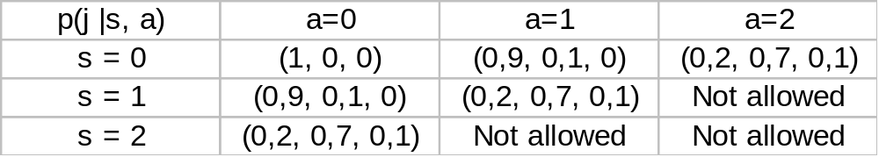
Exemple of inventory management
Decision Epochs T = {0, 1, 2, …, N}
Set of states : S = {0, 1, 2} indicating the initial stock Xt
Action set As : indicating the possible order quantity Ut
A0 = {0, 1, 2}, A1 = {0, 1}, A2 = {0}
Cost function : C_{t}(s, a) = E[a + (s + a – w_{t})²]
Transition probability p_{t}(. |s, a). :

Slide 47
Decision Rules
A decision rule prescribes a procedure for action selection in each state at a specified decision epoch.
A decision rule can be either
Markovian (memoryless) if the selection of action a_{t} is based only on the current state s_{t};
History dependent if the action selection depends on the past history, i.e. the sequence of state/actions h_{t} = (s₁, a₁, …, s_{t-1}, a_{t-1}, s_{t})

Slide 48
Decision Rules
A decision rule can also be either
Deterministic if the decision rule selects one action with certainty
Randomized if the decision rule only specifies a probability distribution on the set of actions.

Slide 49
Decision Rules
As a result, the decision rules can be:
HR : history dependent and randomized
HD : history dependent and deterministic
MR : Markovian and randomized
MD : Markovian and deterministic

Slide 50
Policies
A policy specifies the decision rule to be used at all decision epoch.
A policy π is a sequence of decision rules, i.e. π = {d₁, d₂, …, d_{N-1}}
A policy is stationary if d_{t} = d for all t.
Stationary deterministic or stationary randomized policies are important for infinite horizon markov decision processes.

Slide 51
Example
Decision epochs: T = {1, 2, …, N}
State : S = {s1, s2}
Actions: A_{s1} = {a11, a12}, A_{s2} = {a21}
Costs: C_{t}(s1, a11) =5, C_{t}(s1, a12) =10, C_{t}(s2, a21) = -1, C_{N}(s1) = r_{N}(s2) 0
Transition probabilities: p_{t}(s1 |s1, a11) = 0.5, p_{t}(s2|s1, a11) = 0.5, p_{t}(s1 |s1, a12) = 0, p_{t}(s2|s1, a12) = 1, p_{t}(s1 |s2, a21) = 0, p_{t}(s2 |s2, a21) = 1
a11
a11
a21
{5, .5}
S1
S2
{5, .5}
{-1, 1}
a12
{10, 1}

Slide 52
Example
A deterministic Markov policy
Decision epoch 1:
  d₁(s₁) = a₁₁, d₁(s₂) = a₂₁
Decision epoch 2:
  d₂(s₁) = a₁₂, d₂(s₂) = a₂₁
a11
a11
a21
{5, .5}
S1
S2
{5, .5}
{-1, 1}
a12
{10, 1}

Slide 53
Example
A randomized Markov policy
Decision epoch 1:
  P_{1, s1}(a11) = 0.7, P_{1, s1}(a12) = 0.3
  P_{1, s2}(a21) = 1
Decision epoch 2:
  P_{2, s1}(a11) = 0.4, P_{2, s1}(a12) = 0.6
  P_{2, s2}(a21) = 1
a11
a11
a21
{5, .5}
S1
S2
{5, .5}
{-1, 1}
a12
{10, 1}

Slide 54
Example
A deterministic history-dependent policy
Decision epoch 1: Decision epoch 2:
  d₁(s₁) = a₁₁
  d₁(s₂) = a₂₁
history h d₂(h, s1) d₂(h, s2)
(s1, a11) a13 a21
(s1, a12) infeasible a21
(s1, a13) a11 infeasible
(s2, a21) infeasible a21
a13
{0, 1}
a11
a11
a21
{5, .5}
S1
S2
{5, .5}
{-1, 1}
a12
{10, 1}

Slide 55
Example
A randomized history-dependent policy
Decision epoch 1: Decision epoch 2: at s = s1
P_{1, s1}(a11) = 0.6
P_{1, s1}(a12) = 0.3
P_{1, s1}(a12) = 0.1
P_{1, s2}(a21) = 1
history h P(a = a11) P(a = a12) P(a = a13)
(s1, a11) 0.4 0.3 0.3
(s1, a12) infeasible infeasible infeasible
(s1, a13) 0.8 0.1 0.1
(s2, a21) infeasible infeasible infeasible
a13
{0, 1}
a11
a11
at s = s2, select a21
a21
{5, .5}
S1
S2
{5, .5}
{-1, 1}
a12
{10, 1}

Slide 56
Remarks
Each Markov policy leads to a discrete time Markov Chain and the policy can be evaluated by solving the related Markov chain.

Slide 57
Finite Horizon Markov Decision Processes

Slide 58
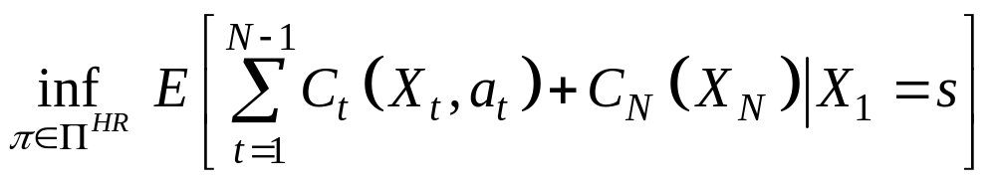
Assumptions
Assumption 1: The decision epochs T = {1, 2, …, N}
Assumption 2: The state space S is finite or countable
Assumption 3: The action space As is finite for each s
Criterion:
where Π^{HR} is the set of all possible policies.

Slide 59
Optimality of Markov deterministic policy
Theorem :
Assume S is finite or countable, and that A_{s} is finite for each s ∈ S.
Then there exists a deterministic Markovian policy which is optimal.

Slide 60
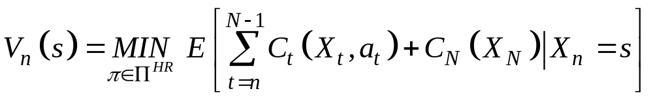
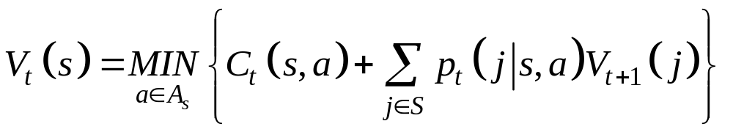
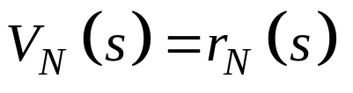
Optimality equations
Theorem : The following value functions
satisfy the following optimality equation:
and the action a that minimizes the above term defines the optimal policy.

Slide 61
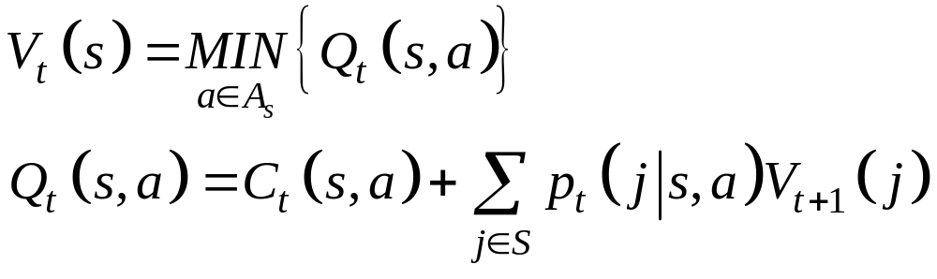
Optimality equations
The optimality equation can also be expressed as:
where Q(s,a) is a Q-function used to evaluate the consequence of an action from a state s.

Slide 62
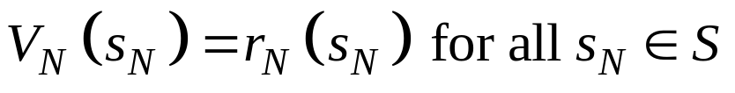
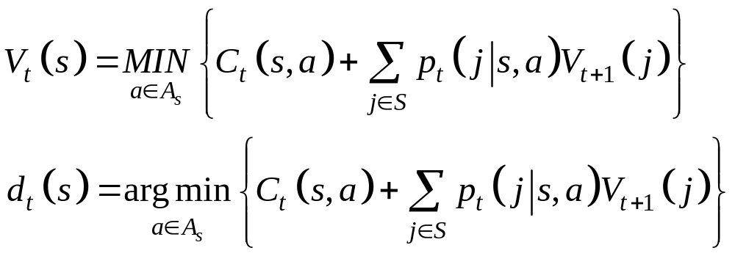
Dynamic programming algorithm
Set t = N and
Substitute t-1 for t and compute the following for each s_{t} ∈S
3. Repeat 2 till t = 1.

Slide 63
Infinite Horizon discounted Markov decision processes

Slide 64
Assumptions
Assumption 1: The decision epochs T = {1, 2, …}
Assumption 2: The state space S is finite or countable
Assumption 3: The action space As is finite for each s
Assumption 4: Stationary costs and transition probabilities; C(s, a) and p(j |s, a), do not vary from decision epoch to decision epoch
Assumption 5: Bounded costs: | C_{t}(s, a) | ≤ Μ for all a ∈ As and all s ∈ S (to be relaxed)

Slide 65
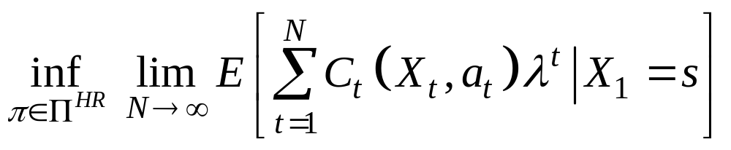
Assumptions
Criterion:
where
  0 < λ < 1 is the discounting factor
  Π^{HR} is the set of all possible policies.

Slide 66
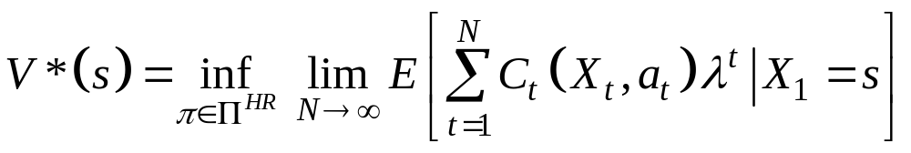
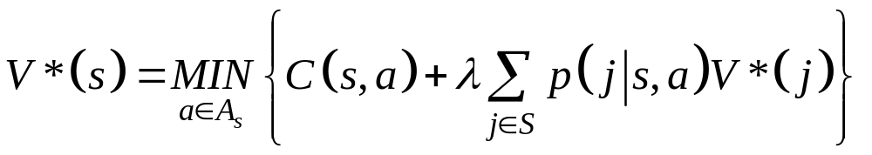
Optimality equations
Theorem: Under assumptions 1-5, the following optimal cost function V*(s) exists:
and satisfies the following optimality equation:
Further, V*(.) is the unique solution of the optimality equation. Moreover, a statonary policy π is optimal iff it gives the minimum value in the optimality equation.

Slide 67
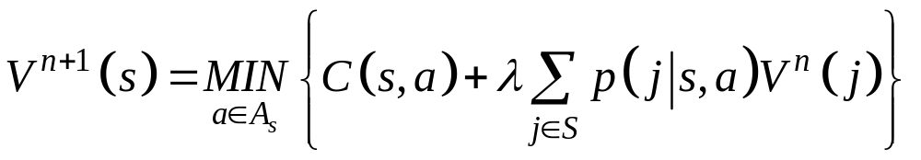
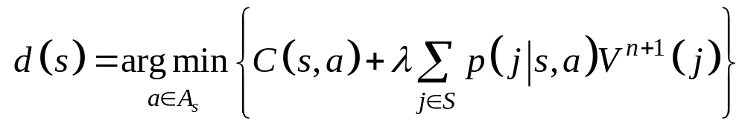
Computation of optimal policy
Value Iteration
Value iteration algorithm:
Select any bounded value function V⁰, let n =0
For each s ∈S, compute
Repeat 2 until convergence.
For each s ∈S, compute

Slide 68
Computation of optimal policy
Value Iteration
Theorem: Under assumptions 1-5,
V^{n} converges to V*
The stationary policy defined in the value iteration algorithm converges to an optimal policy.

Slide 69
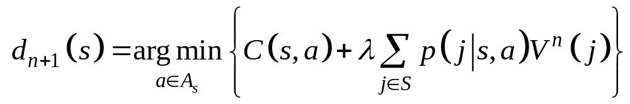
Computation of optimal policy
Policy Iteration
Policy iteration algorithm:
Select arbitrary stationary policy π₀, let n =0
(Policy evaluation) Obtain the value function V^{n} of policy π_{n}.
(Policy improvement) Choose π_{n+1} = {d_{n+1}, d_{n+1},…} such that
Repeat 2-3 till π_{n+1} = π_{n}.

Slide 70
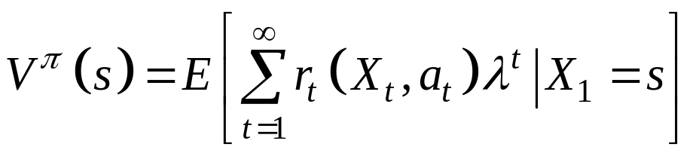
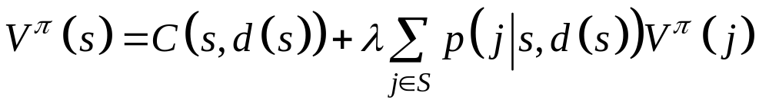
Computation of optimal policy
Policy Iteration
Policy evaluation:
For any stationary deterministic policy π = {d, d, …}, its value function
is the unique solution of the following equation:

Slide 71
Computation of optimal policy
Policy Iteration
Theorem:
The value functions V^{n} generated by the policy iteration algorithm is such that V^{n+1} <= V^{n}.
Further, if V^{n+1} = V^{n}, V^{n} = V*.

Slide 72
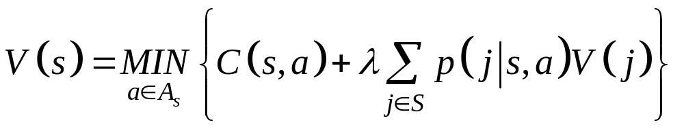
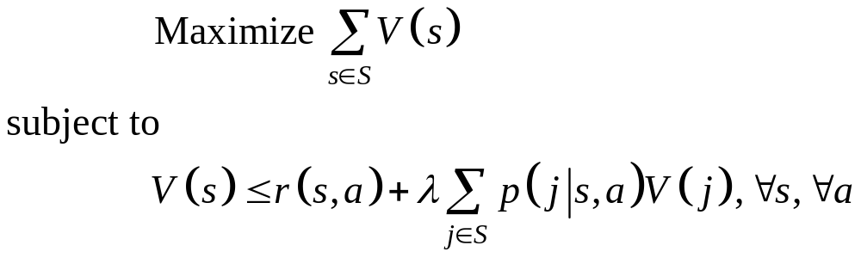
Computation of optimal policy
Linear programming
Recall the optimality equation
The optimal value function can be determine by the following Linear programme:

Slide 73
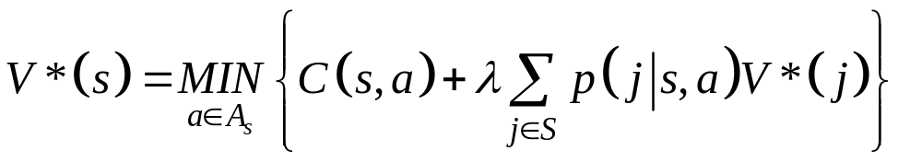
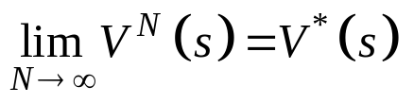
Extensition to Unbounded Costs
Theorem 1. Under the condition C(s, a) ≥ 0 (or C(s, a) ≤0) for all states i and control actions a, the optimal cost function V*(s) among all stationary determinitic policies satisfies the optimality equation
Theorem 2. Assume that the set of control actions is finite. Then, under the condition C(s, a) ≥ 0 for all states i and control actions a, we have
where V^{N}(s) is the solution of the value iteration algorithm with V⁰(s) = 0.
Implication of Theorem 2 : The optimal cost can be obtained as the limit of value iteration and the optimal stationary policy can also be obtained in the limit.

Slide 74
Example
Consider a computer system consisting of M different processors.
Using processor i for a job incurs a finite cost C_{i} with C₁ < C₂ < ... < C_{M}.
When we submit a job to this system, processor i is assigned to our job with probability p_{i}.
At this point we can (a) decide to go with this processor or (b) choose to hold the job until a lower-cost processor is assigned.
The system periodically return to our job and assign a processor in the same way.
Waiting until the next processor assignment incurs a fixed finite cost c.
Question:
How do we decide to go with the processor currently assigned to our job versus waiting for the next assignment?
Suggestions:
The state definition should include all information useful for decision
The problem belongs to the so-called stochastic shortest path problem.

Slide 75
Infinite Horizon average cost Markov decision processes

Slide 76
Assumptions
Assumption 1: The decision epochs T = {1, 2, …}
Assumption 2: The state space S is finite
Assumption 3: The action space As is finite for each s
Assumption 4: Stationary costs and transition probabilities; C(s, a) and p(j |s, a) do not vary from decision epoch to decision epoch
Assumption 5: Bounded costs: | C_{t}(s, a) | ≤ Μ for all a ∈ As and all s ∈ S
Assumption 6: The markov chain correponding to any stationary deterministic policy contains a single recurrent class. (Unichain)

Slide 77
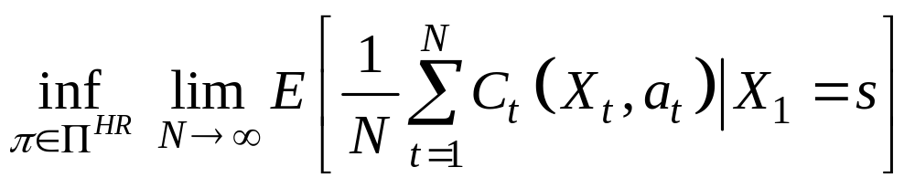
Assumptions
Criterion:
where
  Π^{HR} is the set of all possible policies.

Slide 78
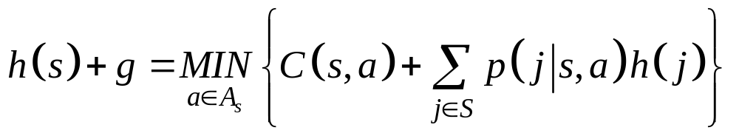
Optimal policy
Under Assumptions 1-6, there exists a optimal stationary deterministic policy.
Further, there exists a real g and a value function h(s) that satisfy the following optimality equation:
For any two solutions (g, h) and (g’, h’) of the optimality equation, (i) g = g’ is the optimal average cost; (ii) h(s) = h’(s) + k; (iii) the stationary policy determined by the optimality equation is an optimal policy.

Slide 79
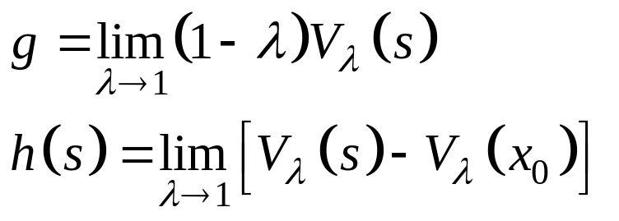
Relation between discounted and average cost MDP
It can be shown that (why? online)
differential cost
for any given state x₀.

Slide 80
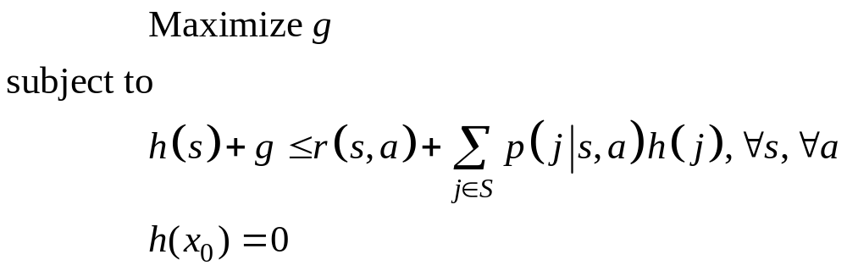
Computation of the optimal policy by LP
Recall the optimality equation:
This leads to the following LP for optimal policy computation
Remarks: Value iteration and policy iteration can also be extended to the average cost case.

Slide 81
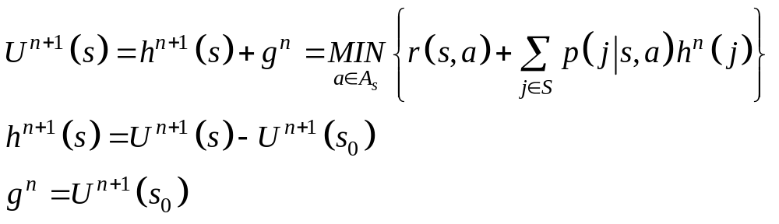
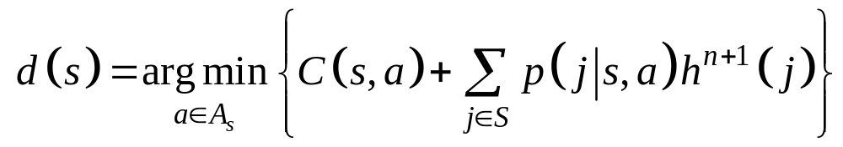
Computation of optimal policy
Value Iteration
Select any bounded value function h⁰ with h⁰(s₀) = 0, let n =0
For each s ∈S, compute
Repeat 2 until convergence.
For each s ∈S, compute

Slide 82
Extensions to unbounded cost
Theorem. Assume that the set of control actions is finite. Suppose that there exists a finite constant L and some state x₀ such that
|V_{λ}(x) - V_{λ}(x₀)| ≤ L
for all states x and for all λ ∈(0,1). Then, for some sequence {λ_{n}} converging to 1, the following limit exist and satisfy the optimality equation.
Easy extension to policy iteration.

Slide 83
Continuous time Markov decision processes

Slide 84
Assumptions
Assumption 1: The decision epochs T = R⁺
Assumption 2: The state space S is finite
Assumption 3: The action space As is finite for each s
Assumption 4: Stationary cost rates and transition rates; C(s, a) and μ(j |s, a) do not vary from decision epoch to decision epoch

Slide 85
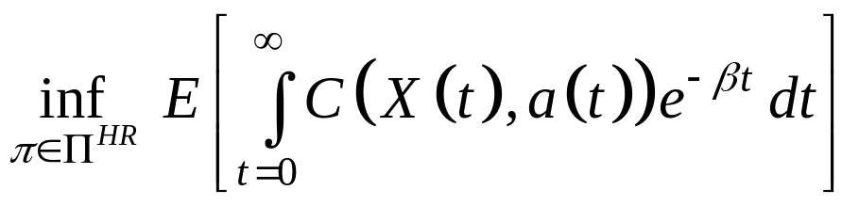
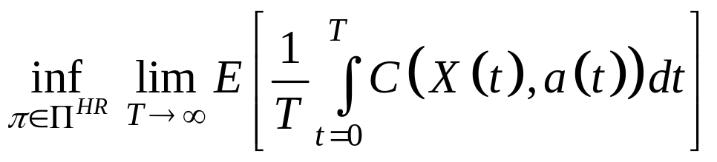
Assumptions
Criterion:

Slide 86
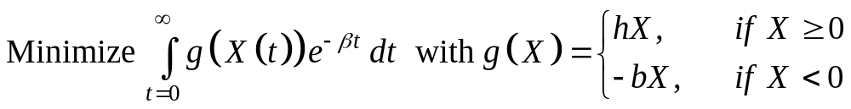
Example
Consider a system with one machine producing one product. The processing time of a part is exponentially distributed with rate p. The demand arrive according to a Poisson process of rate d.
state Xt = stock level, Action : a_{t} = make or rest
(make, p)
(make, p)
(make, p)
(make, p)
1
0
2
3
d
d
d
d

Slide 87
Uniformization
Any continuous-time Markov chain can be converted to a discrete-time chain through a process called « uniformization ».
Each Continuous Time Markov Chain is characterized by the transition rates μ_{ij} of all possible transitions.
The sojourn time T_{i} in each state i is exponentially distributed with rate μ(i) = Σ_{j≠i} μ_{ij}, i.e. E[T_{i}] = 1/μ(i)
Transitions different states are unpaced and asynchronuous depending on μ(i).

Slide 88
Uniformization
In order to synchronize (uniformize) the transitions at the same pace, we choose a uniformization rate
γ ≥ MAX{μ(i)}
« Uniformized » Markov chain with
transitions occur only at instants generated by a common a Poisson process of rate γ (also called standard clock)
state-transition probabilities
p_{ij} = μ_{ij} / γ
p_{ii} = 1 - μ(i)/ γ
where the self-loop transitions correspond to fictitious events.

Slide 89
Uniformization
CTMC
a
Step1: Determine rate of the states
μ(S1) = a, μ(S2) = b
Step 2: Select an uniformization rate
γ ≥ max{μ(i)}
Step 3: Add self-loop transitions to states of CTMC.
Step 4: Derive the corresponding uniformized DTMC
S1
S2
b
Uniformized CTMC
γ-a
a
γ-b
S1
S2
b
DTMC by uniformization
1-a/γ
a/γ
1-b/γ
S1
S2
b/γ

Slide 90
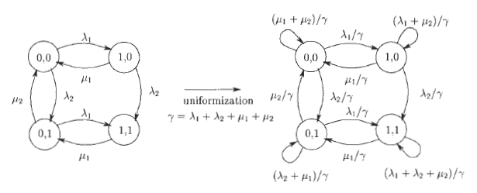
Uniformization
Rates associated to states
μ(0,0) = λ1+λ2
μ(1,0) = μ1+λ2
μ(0,1) = λ1+μ2
μ(1,1) = μ1

Slide 91
Uniformization
For Markov decision process, the uniformization rate shoudl be such that
γ ≥ μ(s, a) = Σ_{j∈S} μ(j|s, a)
for all states s and for all possible control actions a.
The state-transition probabilities of a uniformized Markov decision process becomes:
p(j|s, a) = μ(j|s, a)/ γ
p(s|s, a) = 1- Σ_{j∈S} μ(j|s, a)/ γ

Slide 92
Uniformization
(make, p)
(make, p)
(make, p)
(make, p)
1
0
2
3
d
d
d
d
Uniformized Markov decision process
at rate γ = p+d
(make, p/γ)
(make, p/γ)
(make, p/γ)
(make, p/γ)
(make, p/γ)
0
1
2
3
d/γ
d/γ
d/γ
d/γ
d/γ
(not make, p/γ)
(not make, p/γ)
(not make, p/γ)
(not make, p/γ)

Slide 93
Uniformization
Under the uniformization,
  a sequence of discrete decision epochs T₁, T₂, … is generated where T_{k+1} – T_{k} = EXP(γ).
  The discrete-time markov chain describes the state of the system at these decision epochs.
  All criteria can be easily converted.
continuous cost C(s,a) per unit time
fixed cost k(s,a, j)
fixed cost K(s,a)
(s,a)
j
EXP(γ)
EXP(γ)
EXP(γ)
T0
T1
T2
T3
Poisson process at rate γ

Slide 94
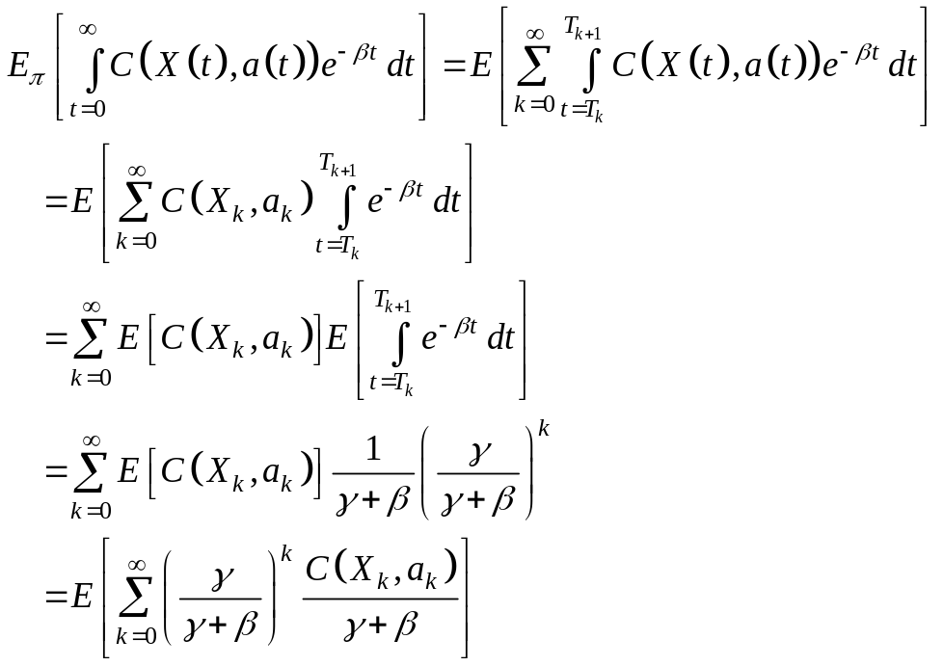
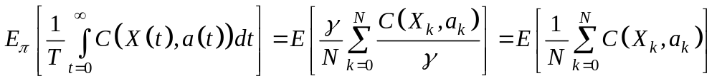
Cost function convertion for uniformized Markov chain
Discounted cost of a stationary policy π (only with continuous cost):
State change & action taken only at T_{k}
Mutual independence of (X_{k}, a_{k}) and (T_{k}, T_{k+1})
T_{k} is a Poisson process at rate γ
Average cost of a stationary policy π (only with continuous cost):

Slide 95
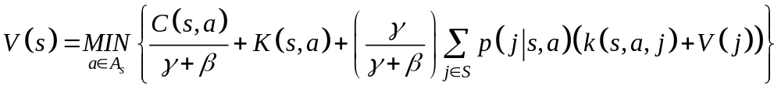
Cost function convertion for uniformized Markov chain
Equivalent discrete time discounted MDP
  a discrete-time Markov chain with uniform transition rate γ
  a discount factor λ = γ/(γ+β)
  a stage cost given by the sum of
    continuous cost C(s, a)/(β+γ),
    K(s, a) for fixed cost incurred at T₀
    λk(s,a,j)p(j|s,a) for fixed cost incurred at T₁
Optimality equation

Slide 96
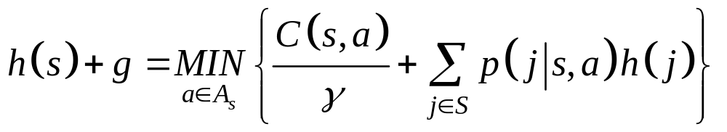
Cost function convertion for uniformized Markov chain
Equivalent discrete time average-cost MDP
  a discrete-time Markov chain with uniform transition rate γ
  a stage cost given by C(s, a)/γ whenever a state s is entered and an action a is chosen.
Optimality equation :
where
g = average cost per discretized time period
gγ = average cost per time unit (can also be obtained directly from the optimality equation with stage cost C(s, a))

Slide 97
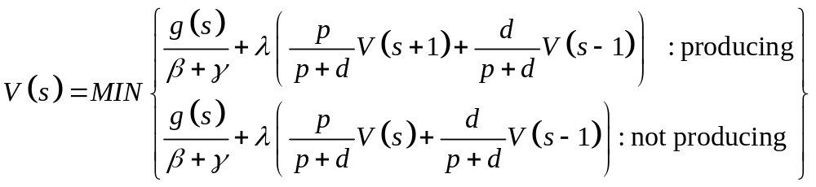
Example (continue)
Uniformize the Markov decision process with rate γ = p+d
The optimality equation:

Slide 98
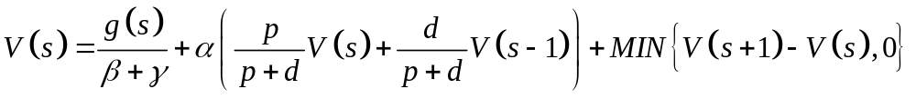
Example (continue)
From the optimality equation:
If V(s) is convex, then there exists a K such that :
V(s+1) –V(s) > 0 and the decision is not producing, for all s >= K and
V(s+1) –V(s) <= 0 and the decision is producing, for all s < K

Slide 99
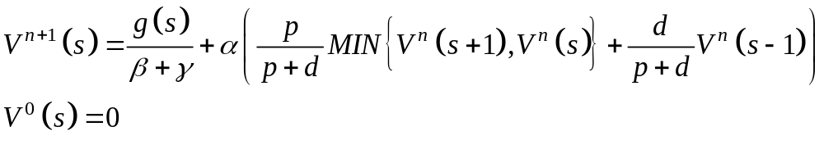
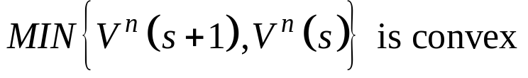
Example (continue)
Convexity proved by value iteration
Proof by induction.
V⁰ is convex.
If V^{n} is convex with minimum
at s = K, then V^{n+1} is convex.
s
K-1
K

